Slide 1
TEAM-RESOURCE
addTeam
getAllTeams
getTeamById
getUsersFromTeam
getWorkItemsFromTeam
updateTeam
addUserToTeam

Slide 2
TEAM-RESOURCE
addTeam
getAllTeams
getTeamById
getUsersFromTeam
getWorkItemsFromTeam
updateTeam
addUserToTeam

Slide 3
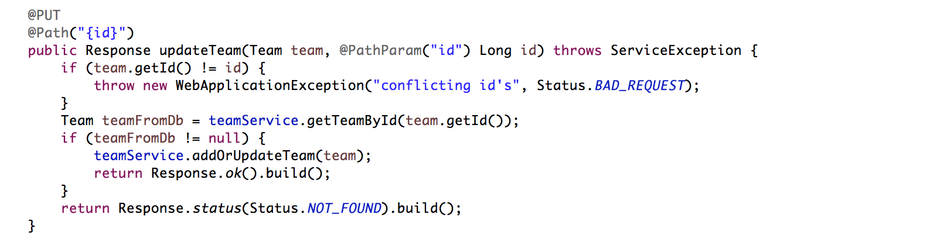

Slide 4
TEAM-RESOURCE
addTeam
getAllTeams
getTeamById
getUsersFromTeam
getWorkItemsFromTeam
updateTeam
addUserToTeam

Slide 5
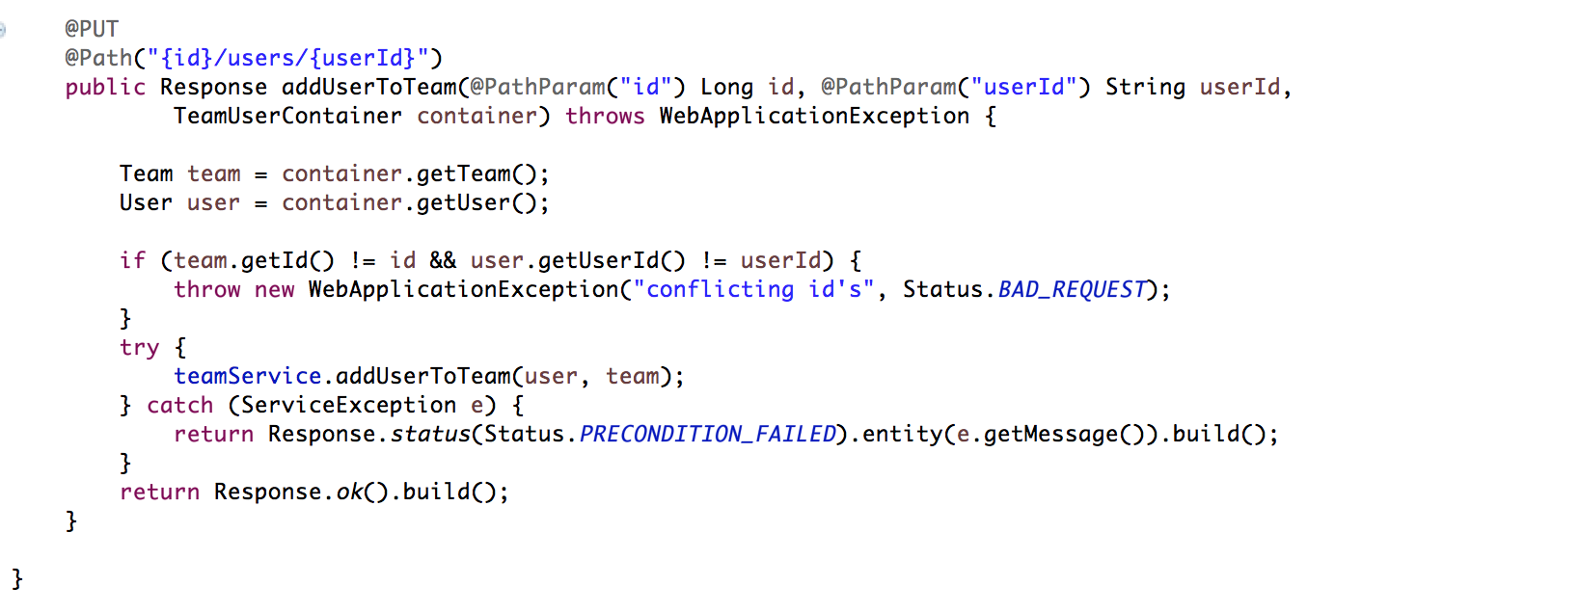

Slide 6
Taskmanager
Projektarbete - Java Webbteknik

Slide 7
Relations
Team
User
Workitem
Issue

Slide 8
business logic
Affärslogik: “User”
- En User måste ha ett användarnamn som är minst 10 tecken långt - När en User inaktivares ändras status på alla dennes WorkItem till Unstarted

Slide 9
Service
Repository
Database
MySql
Taskmanager-Api
Service
Repository

Slide 10

“API”
Request
Resource
Service
Repository
Database
MySql
Response
Resource
Service
Repository

Slide 11
StödOrderFÖrDenna??

Slide 12
DREAMIERTEAM OUT!!!
Eclipse

